Slide 1
Code 45 USW Platforms & Payload Integration Department Major Ship Alteration Engineering and Technical Support Services Industry Day
NUWC Division Newport
Building 80
September 7th, 2023
SSIC: 4200

Slide 2
Agenda
Introduction/Ground Rules
Disclaimer Statement
Department Overview
Anticipated Procurement Strategy
Contract Details
Conclusion/Wrap-up
2

Slide 3
Introduction/Ground rules
Introduction of Participants
Intent of this Pre-Solicitation Conference
Encourage competition by:
Providing technical information to provide potential offerors a better understanding of the technical requirements
For Prime and Subcontracting opportunities
Ensure all potential offerors receive, and have access to, the same information
Technical “Q&A” is encouraged
Pre-submitted questions will be addressed at the end.
Q&A will be answered via SeaPort NxG Portal
Q&A/Feedback Forms
No questions about incumbent contractor
3

Slide 4
Introduction/Ground rules (cont’d)
Please silence cell phones and pagers. No personal recording
Q&A will be recorded, typed, and posted to the SeaPort NxG Portal
The Attendees list will be posted to the SeaPort NxG Portal
This briefing will be posted to Seaport NxG and the Contracting & Small Business Outreach page: https://www.navsea.navy.mil/Home/Warfare-Centers/NUWC-Newport/Partnerships/Contracting-and-Small-Business/Outreach-Events/
DO NOT directly contact the NUWC technical code after today all further dialogue will be accomplished via the Q&A feature on the SeaPort NxG Portal
Technical requirements contained in this briefing are presented as a draft summary
Full/updated technical requirements will be provided in the Request for Proposal (RFP)
4

Slide 5
Disclaimer Statement
Remarks today by Government officials involved in the Code 45 Major Ship Alteration Support Services requirement should not be considered a guarantee of the Government’s course of action in proceeding with the acquisition
The informational briefing shared today reflects current Government intentions and is subject to change based on a variety of circumstances
The formal solicitation, when issued, is the only document that should be relied upon in determining the Government’s requirements
5

Slide 6
Department Overview
Our Mission:
Exercise full-spectrum programmatic and technical excellence in tactical missile, payload integration and USW platform solutions to deliver and sustain USW capability.
Our Vision:
Exploit the Ocean Interface for USW Platform & Payload Superiority.
6
6

Slide 7
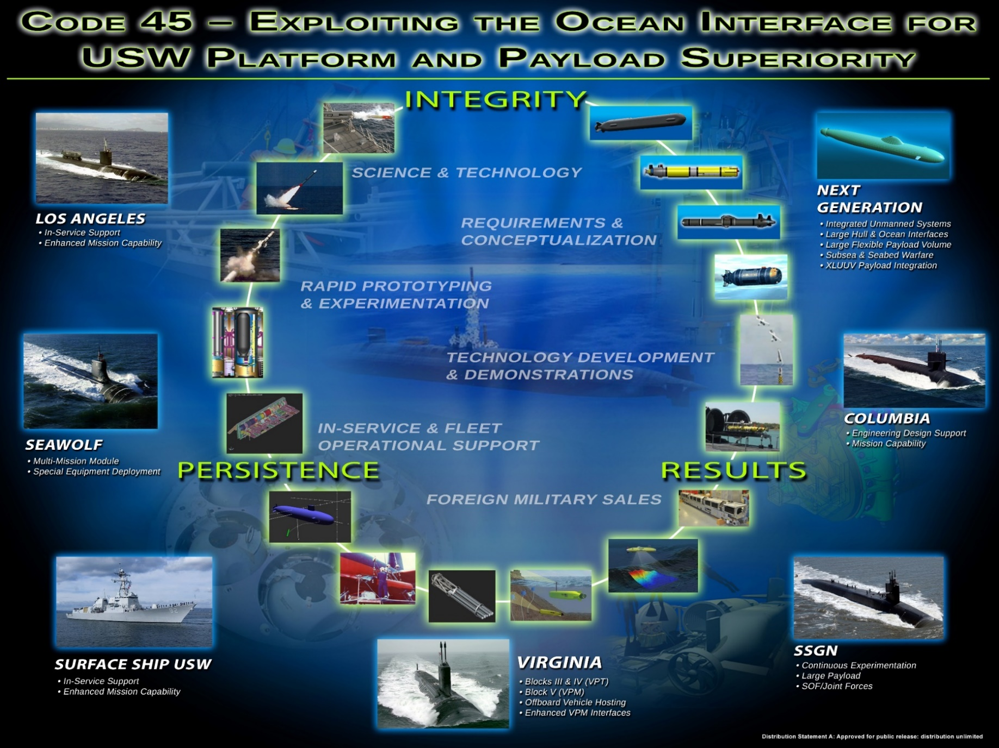
Department Overview (cont’d)

Slide 8
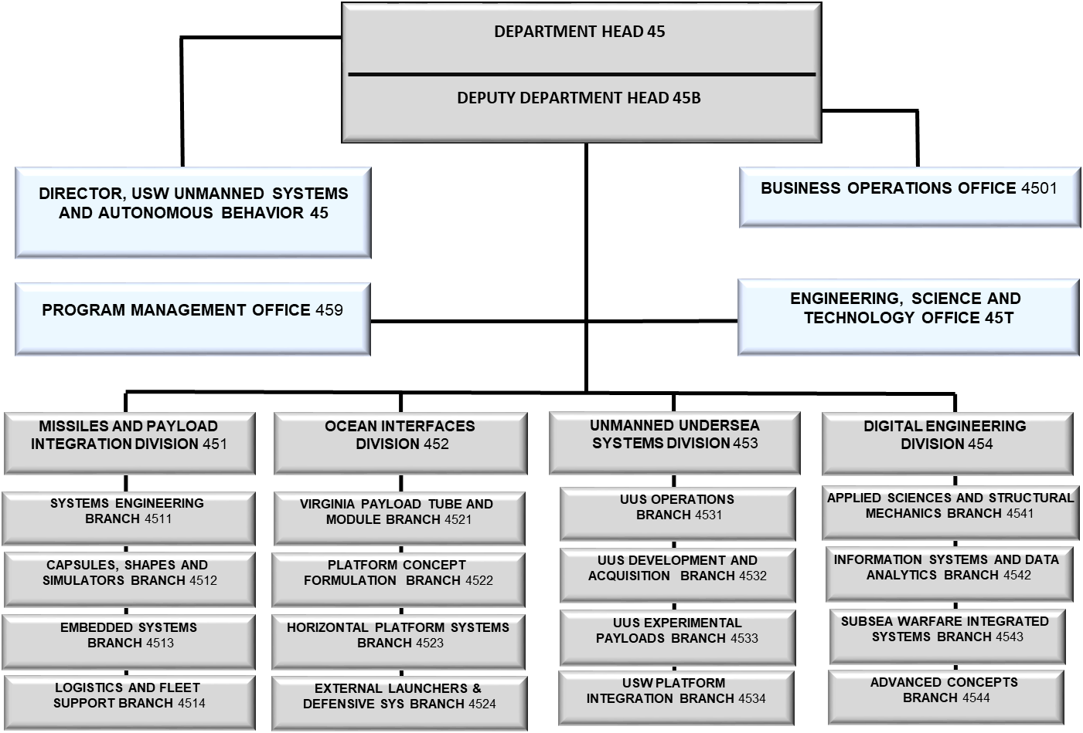
Department Overview (cont’d)
C45 Org Chart
8

Slide 9
Department Overview (cont’d)
C45 Demand Increase Summary
NP09 - USW Launcher Systems and Payload Integration
Growth across the customer base in support of multiple new alteration efforts and increases in SSN(X) tasking, Virginia Payload Module analytical requirements and continued integration efforts of Undersea Dominance Payloads
NP10 – Submarine Tactical Missile Integration
Strategic System Programs All Up Round simulator efforts leveraging Tomahawk MK112
Foreign Military Sales efforts remain stable with planned growth due to AUKUS
NP11 - USW Autonomous Vehicles
Growth across the customer base for payload and sensor development and integration, Large Vehicle Integration, Full Spectrum Undersea Warfare Innovative Naval Prototype and Joint Undersea Surveillance and Targeting support, Autonomy integration and Digital Engineering Efforts, along with increasing requirements associated with C45's UUV Software Support Agent Role
NP20 - Subsea and Seabed Systems
Growth across the customer base for payload, sensor and platform development and integration

Slide 10
Anticipated Procurement Strategy
Summary of Contract Scope
Perform the design, development, engineering, assembly, fabrication, testing, documentation, software development, cyber security, training and technical services for our programs in the following areas:
Major Ship Alterations Technical Data Package (TDP) Development & Approval
Major Ship Alterations System Hardware/Software Design, Fabrication, Test and Installation
Major Ship Alterations System Demonstration, Maintenance and Repair
Major Ship Alterations System Removal and Restoration
10

Slide 11
Anticipated Procurement Strategy (con’t)
RFP: N66604-23-R-3017
Contracting Method: SeaPort NxG
Anticipated Period of Performance: 06/30/2024-06/29/2029
Acquisition Strategy: Unrestricted
Level of Effort Estimate: 474,250hrs /$17,980,844 ODCs 32%)
Anticipated Work Location: 20% Government Site, 80% Contractor, installation and or test site.
Contract Type: CPFF, Cost Reimbursement (Cost Only) provisions for ODC’s
11

Slide 12
Anticipated Procurement Strategy (con’t)
Unique Characteristics
Key Personnel requirements: STR plus a Minimum of 3 Key Personnel to Cover Designated Areas of Expertise
Senior Engineer for design to cover ship check and data package development through final approval; includes research and getting documents through NAVSEA approval board.
Senior Engineer for installation to cover procurement and fabrication of all materials, cabling, etc.; oversees physical install and departure from specification approval and removal.
Senior Computer Engineer to cover all software design, documentation, test and evaluation, obtaining Authority to Test and Authority to Operate.
Each should have 10 plus years experience with tasking, minimum of Bachelors level degree, 5 plus years managing team performing tasks. Prior submarine service and higher level degrees are favorable.
Facility Security Clearance: TS-SCI Access. Secret Safeguarding
12

Slide 13
Anticipated Procurement Strategy (con’t)
Required Certifications/Designations:
Capability Maturity Model Integration (CMMI) Level 3 or equivalent
Earn and maintain appropriate baseline certification as identified in DOD 8570.01-M, DOD Int 8140.01 and SECNAV M-5239.2 for the position and tasking being performed
ODCs primarily for travel and incidental pieces for the major shipboard alteration to the specific ship. Approximately 32% are ODCs.
Follow-on to N00178-04-D-4010/N66604-19-F-3011, American Systems, Acquisition Strategy was Unrestricted
OCOI clause applies
Expected RFP release: FY24 QTR 1
Expected Award Date: June 2024
13

Slide 14
Technical Requirements
Background
NUWCDIVNPT is tasked by various sponsors to serve in the capacity as Technical Direction Agent (TDA), Software Support Agent (SSA), and In-Service Engineering Agent (ISEA) for various submarine-installed systems that collect navigation, oceanographic, targeting and other data, as well as other sensor systems data, on board submarines.
Scope
Provide engineering and technical services necessary to design, fabricate, test, install, software development, cyber security, operate and remove submarine equipment using NAVSEA-developed alterations.
14

Slide 15
Technical Requirements (cont’d)
Major Ship Alteration Engineering and Technical Support Services
The Major Ship Alteration contract provides services in the following areas :
Research and Development support
Engineering, System Engineering and Process Engineering Support
Developmental, Pre-Production, Model-Making, and Fabrication Support
System Design Documentation and Technical Data Support
Software Engineering, Development, Programming, and Network Support
Configuration Management (CM) Support
Information System (IS), Information Assurance (IA), & Information Technology (IT) Support
Interoperability, Test and Evaluation, Trials Support
Supply and Provisioning Support
Training Support
In-Service Engineering, Fleet Introduction, Installation and Checkout Support
Functional and Administrative Support
15
Notes:
15

Slide 16
Technical Requirements (cont’d)
Task 1: Alteration Technical Data Package (TDP) development and approval
Gather ship and platform technical information
Perform pre-installation ship-checks
Analyze ship and platform information for configuration, schedule and cost impact for installation of system(s)
Develop the TDP, or update an existing TDP
Develop new or modify existing software and firmware for operation, calibration, data collection and data analysis
In order to gain Interim Authority to Test (IATT), Authority to Test (ATT), Interim Authority to Operate (IATO) and Authority to Operate (ATO) the following needs to be accomplished
Coordinate TDP Cyber Security and Risk Management Framework (RMF) documentation;
Provide Cyber Security inputs at design reviews;
Provide Cyber Security mitigation of design implications;
Adjudicate comment and documentation update via the review/approval process;
Provide problem resolution for all Systems and Programs Baseline Accreditations
16

Slide 17
Technical Requirements (cont’d)
Task 2: Alteration Systems Fabrication, Test and Installation
Design, fabricate and assemble new units (developmental, interface, data acquisition), data recorders, cabling, mounts and hardware for the systems and equipment
Test and verify operation and function the systems, components and equipment prior to installation
Design, fabricate or procure components, equipment and tooling for shipboard installation.
Draft, develop, maintain Departure from Specification (DFS) documentation for review/approval
Provide engineering and technical services for system operational tests to confirm function, installation and operational requirements are met
Prepare/ provide Operation and Maintenance Instructions for Research and Development equipment
Conduct Operation and Maintenance training for Government personnel
Scan the system and equipment, collect security scanned data, validate baseline accreditation, and generate the ATO naval message for each boat
Conduct Cyber Security Training for the submarine’s Information Assurance Officer (IAO)
Generate a Security Assessment Report (SAR) and System Security Plan (SSP)
17

Slide 18
Technical Requirements (cont’d)
Task 3: Alteration Demonstration, Maintenance and Analysis
Maintain laboratory systems, alteration systems and equipment with required Cyber Security scanning patches
Implement or update the hardware and software systems
Provide planning, execution and analysis in support of demonstrations and functional tests
Repair, replace or modify any hardware or software necessary to successfully complete tests
Field trouble calls
Replace, repair or modify systems and equipment as necessary to return the system to ‘In-Service’ status
18

Slide 19
Technical Requirements (cont’d)
Task 4: Alteration Removal and Restore
Remove the installed systems and equipment from the submarine
Return the affected shipboard systems and hull configurations to their original state
Package and ship equipment to NUWCDIVNPT, contractor’s facility, warehouse or installation site
19

Slide 20
Conclusion/Wrap-up
Thank you for your interest in the Code 45 USW Platforms & Payload Integration Department Major Ship Alteration Engineering and Technical Support Services requirement
The attendees list will be posted to the SeaPort NxG Portal
This briefing will be posted to Seaport NxG and the Contracting & Small Business Outreach page
“Q&A” (today’s and any subsequent) will be posted to the SeaPort NxG Portal
DO NOT contact today’s presenters
All further dialogue will be accomplished via the Q&A feature on the SeaPort NxG Portal
20

